Slide 1
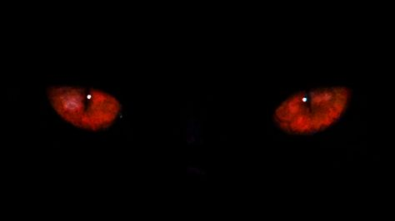
Chupacabra
Alien Vampire or Vampiric Canine, a Dichotomy Between ‘Murican and Latin American Cultures
Presented by Brian Williams
Sponsorships from:
Barrel Fires of Albuquerque and Chateau Coalliams BnB in Bellevue, WA

Slide 2
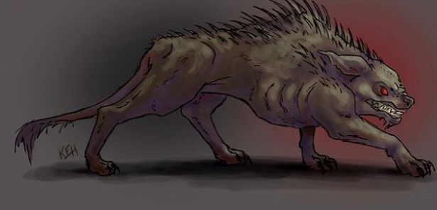
What is in a Name?
Chupacabra
Portmanteau
Chupar – “To Suck”
Cabra – “Goat”
“GoatSucker”
Coined by Puerto Rican Comedian and Entrepreneur Silverio Perez

Slide 3

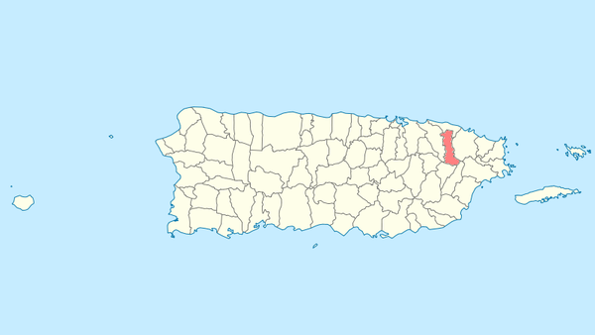
The First Report
Puerto Rico – March, 1995
8 sheep were discovered dead with 3 puncture wounds in the chest and drained of blood
August 1995: Madelyne Tolentino reported seeing the creature in Canóvanas when as many as 150 farm animals were reportedly killed.

Slide 4
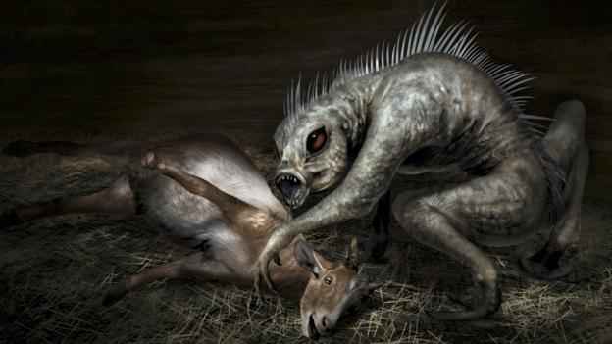
Physical Description
Length: 4-5 feet (Nose to Tail)
Weight: 35-45 lbs (Males are larger than Females)
Color: Grey
Body: Sparsely covered in scales with a spiked back
Carnivorous mouth features

Slide 5
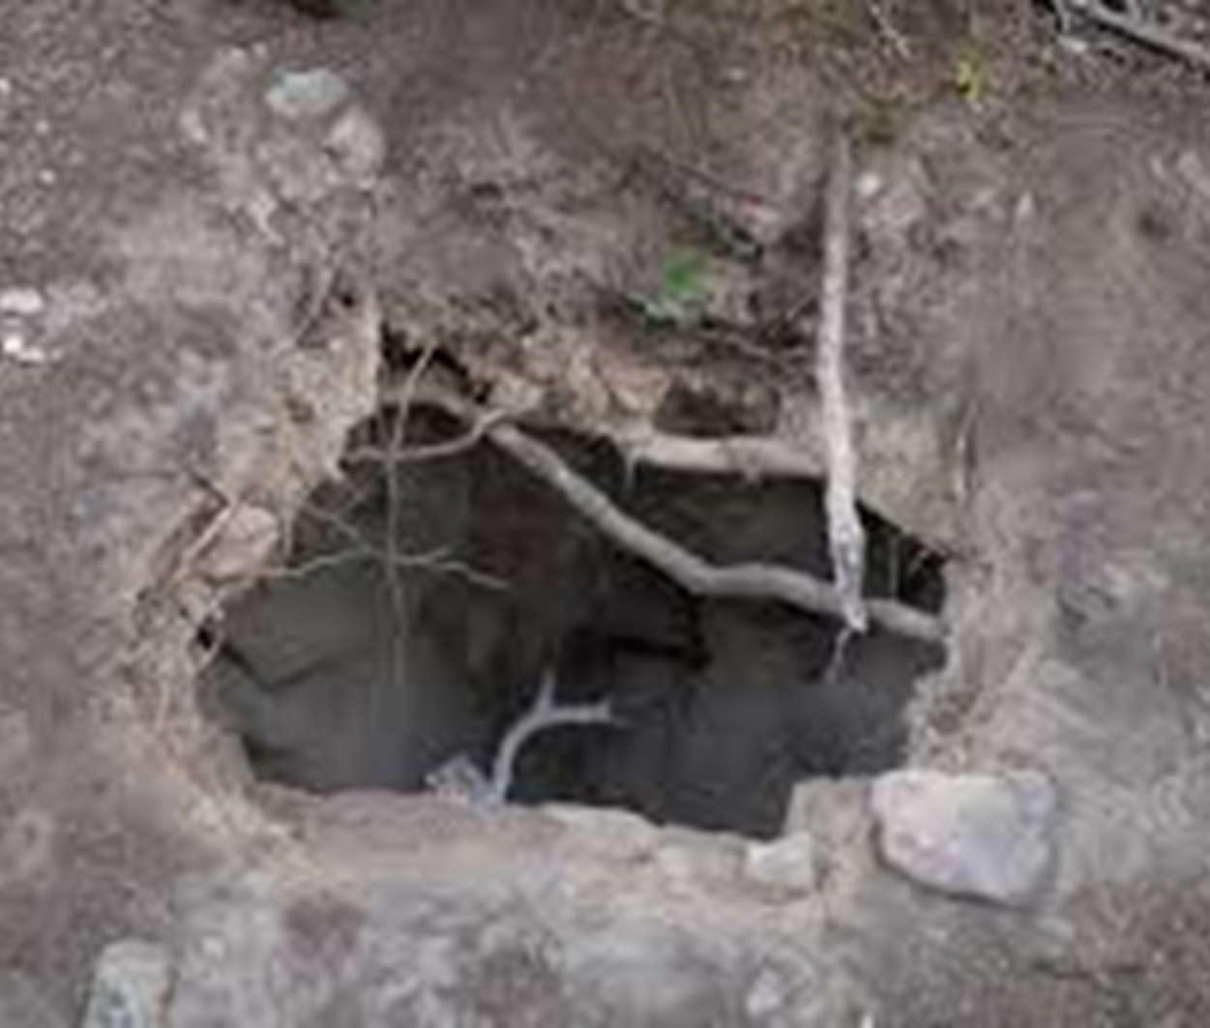
Preferred Habitat and Threats
Live in Dens
Deserts
Grasslands
Dry Forest Areas
Near Farmlands (close to a constant food source)
They are found mainly in the mid-south United States and in Central America
Roaming Territory ranges from 3 to 16 sq. km.
They are in areas with light human populations as they are shy and extremely cautious
They avoid areas with dense road infrastructures. Often, they stay over 1km away from roads to avoid humans and vehicles.

Slide 6
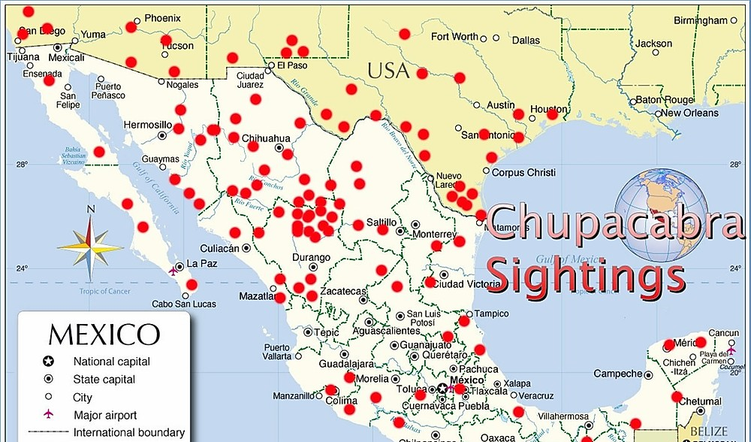
Subsequent Reported Sitings
As far west as California
As far northeast as NC
Through Central America

Slide 7
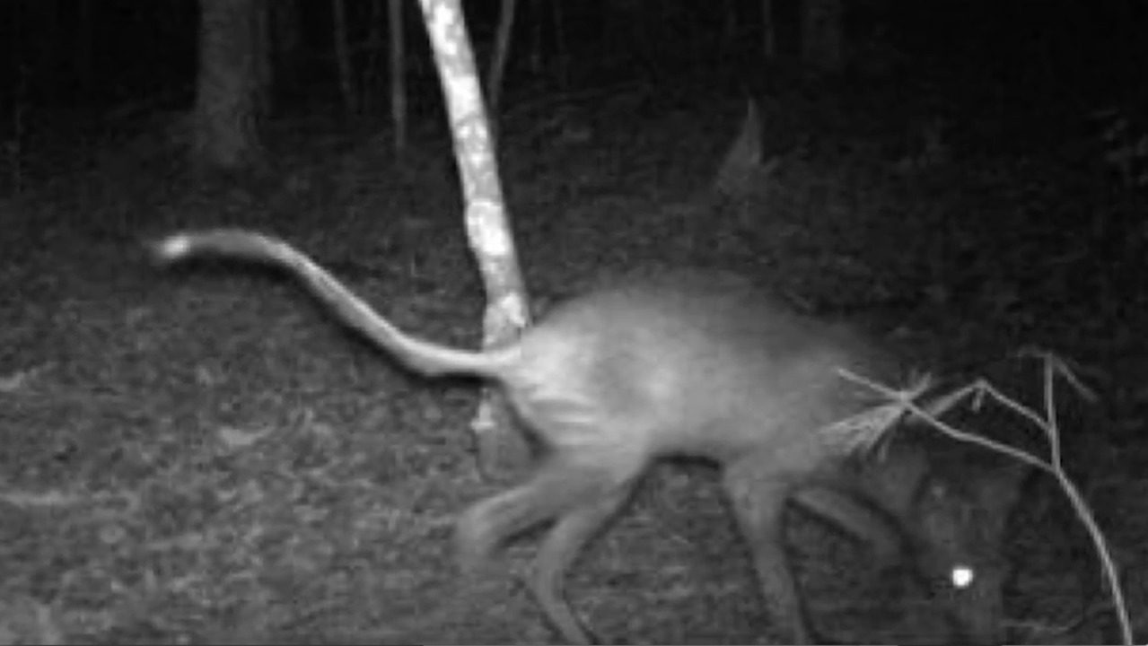
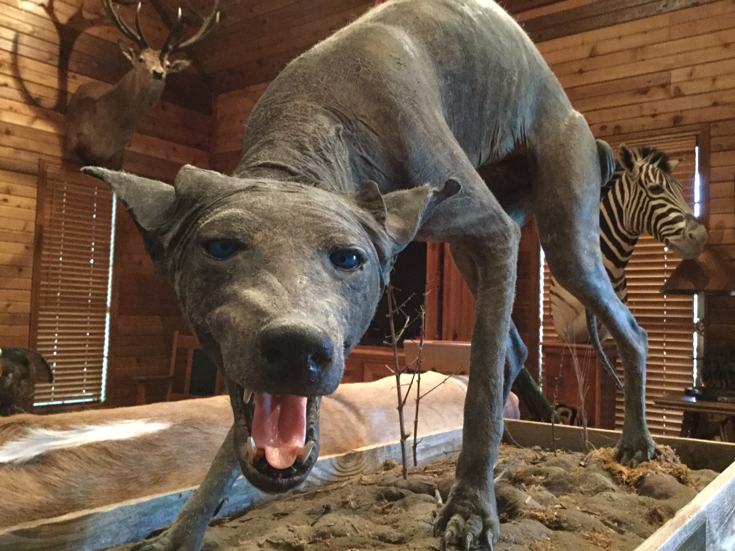
Evolution in Different Ecosystems
In the Mainland Americas, Chupacabra takes a different form:
Appear to be part of the Canidae Family
Possess little to no fur and leathery skin
Often falsely assumed as reptiles
Large fangs
Long Tail

Slide 8
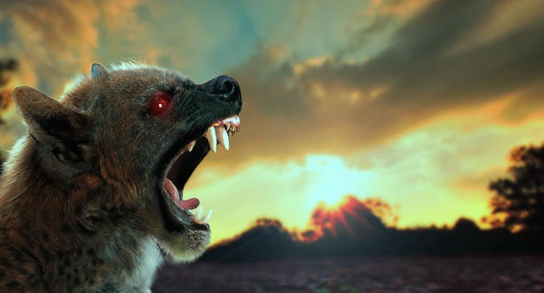
Haters will say its fake (Myth Debunking)
The movie “Species”
Necropsy
Mange
Sarcoptes Scabiei

Slide 9
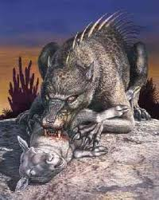
Questions?
Special thanks to BarrelFires of Albuquerque and Chateau Coalliams

